Slide 1
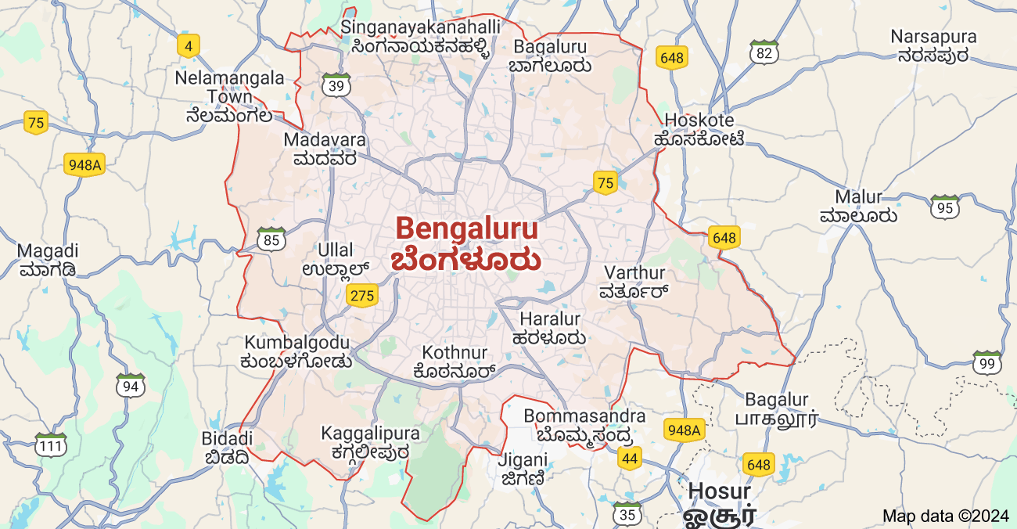
Predicting the success of the restaurants in Bangalore city

Slide 2
Introduction
The basic idea of analyzing the zomato dataset is to get a fair idea about the factors affecting the establishment of different types of the restaurant at different places in Bangalore, analyzing the ratings of each restaurant as the ratings decide how good a restaurant is.
Opportunity:-
From all the Data available, we can bring out some neat insights or conclusions such as:-
Which are the top 10 restaurant in each rest_type category?
How many restaurants are accepting online orders?
How many restaurants have book table facility?
Tools Used:-
Python
PowerBI

Slide 3
About The Dataset
This is publicly available dataset on kaggle based upon restaurant listed on zomato website for Bangalore city.
Dataset Name : Zomato Bangalore Restaurants
Dataset Properties:-
This dataset contains 17 columns and 51000 rows
1.URL
2.Address
3.Name
4.Online-Order
5.Book-Table
6.Rate
7.Votes
8.Phone No.
9.Location
10.Restaurant type
11.Dish Liked
12.Cuisines
13.Cost for 2
14.Review list
15.Menu Item
16.Listed in type
17.Listed in city

Slide 4
Initial EDA
Checking the column names
Shape of the dataset
Checking for null values
Data Preprocessing
Data Cleaning:-
Dropping unnecessary columns named URL,address,phone,dishliked,menu and review list.
Dropping duplicate values.
Datatype handling
Handling the Rate column
Rate column had values like “NEW” and “-”,they were replaced with nan.Using SimpleImputer later these null values were filled with the mean.
By using split function 4.1/5 was split and replaced with 4.1 and its data type was changed to float.

Slide 5
Simply,dropping the null values present in location,cuisines.
Handling Approximate cost for 2 column.
It’s column datatype was changes to float and “,” was removed.
Using LabelEncoding on columns online_order,book_table.
After performing data cleaning there were exactly 50487 rows and 11 columns.

Slide 6
Feature Engineering
Creating new columns named “number of types” and “number of cuisines” that will provide us the count of respective columns.
Creating a column named “target” for determining whether the restaurant is successful or not,we use median of restaurant rates as our threshold.
If rate >=3.75 successful
If rate <3.75 not that good
Feature Selection
The features used for making prediction are online_order,book_table,approximate_cost for 2 people,votes,number of cuisines and number of types.
Feature Scaling
Using StandardScaler as data has diverse values we need to normalize it.

Slide 7
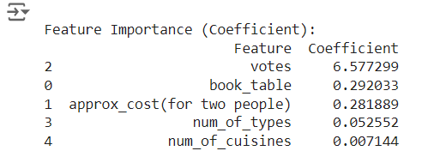
Results:-
Model | Accuracy | Recall
LogisticRegression | 80% | 85%
KNN | 88% | 83%
SVM | 81% | 84%
What makes restaurants hold a good rating?
ANS:Votes

Slide 8
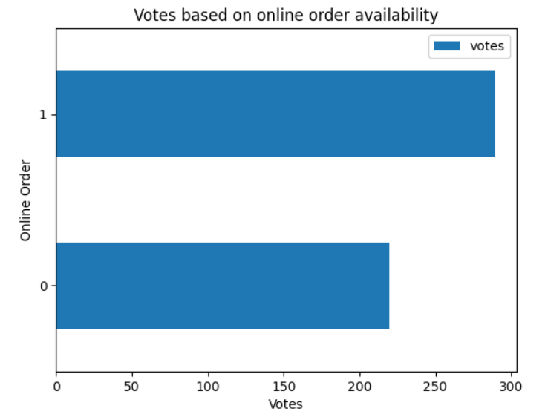
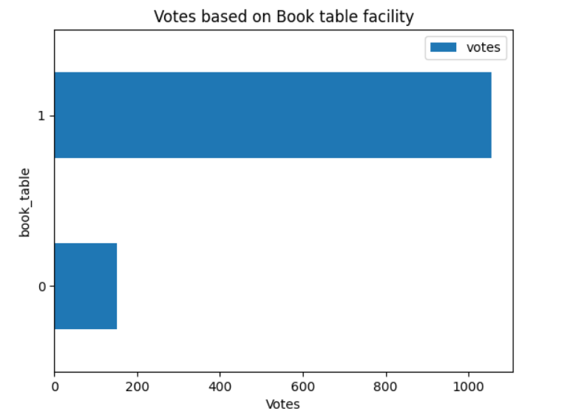
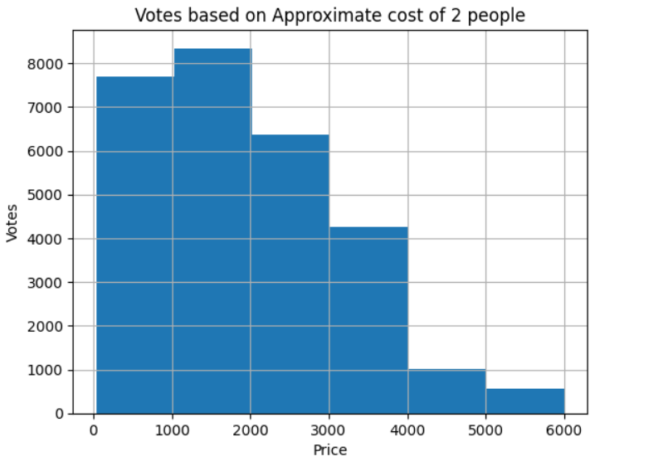
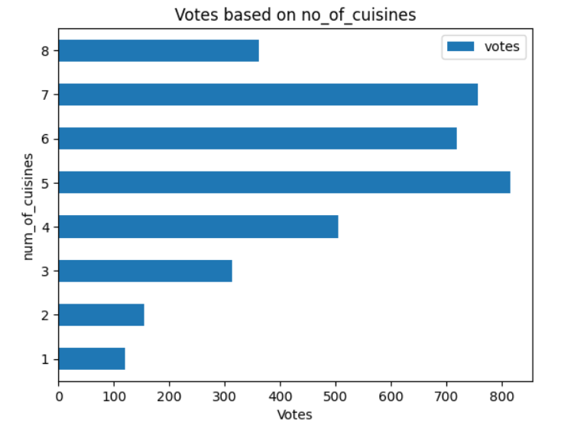
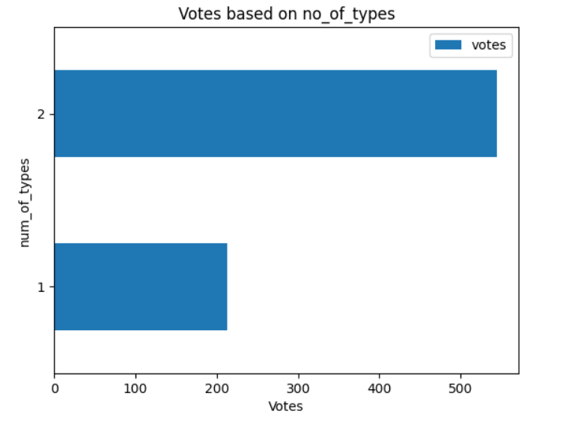
Conclusion:-

Slide 9
A restaurant must have book table facility,it is seen from the graph that rating of the restaurant that can book a table is high as compared to those who dnt.
A restaurant that has more than 1 type has more votes.
Price between (1000-2000) i.e affordable prices means high votes.Therefore to build a successful restaurant,one must built it with affordable prices.

